Slide 1
CEIS101 Module 3
Inventory and Organization

Slide 2
Rubric
Activity | Requirement(s) | Points
Installing Arduino IDE | Screenshot of Arduino IDE | 30
LED blink | Picture of circuit | 30

Slide 3
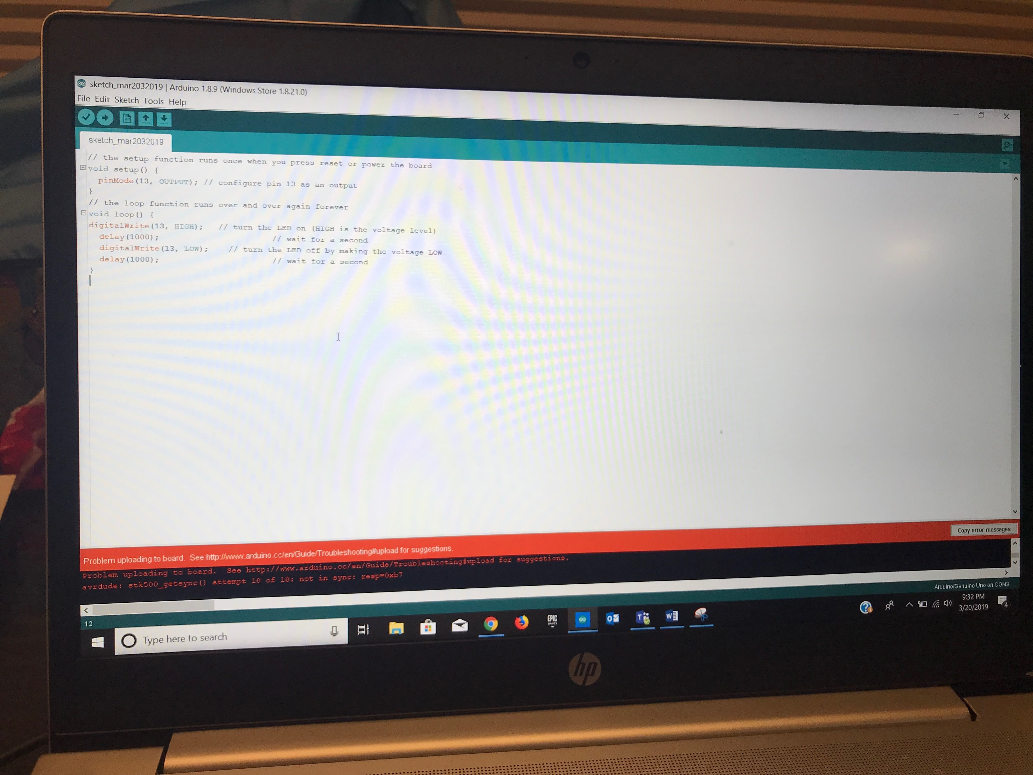
Arduino IDE (Screenshot)
Blank Arduino Sketch

Slide 4
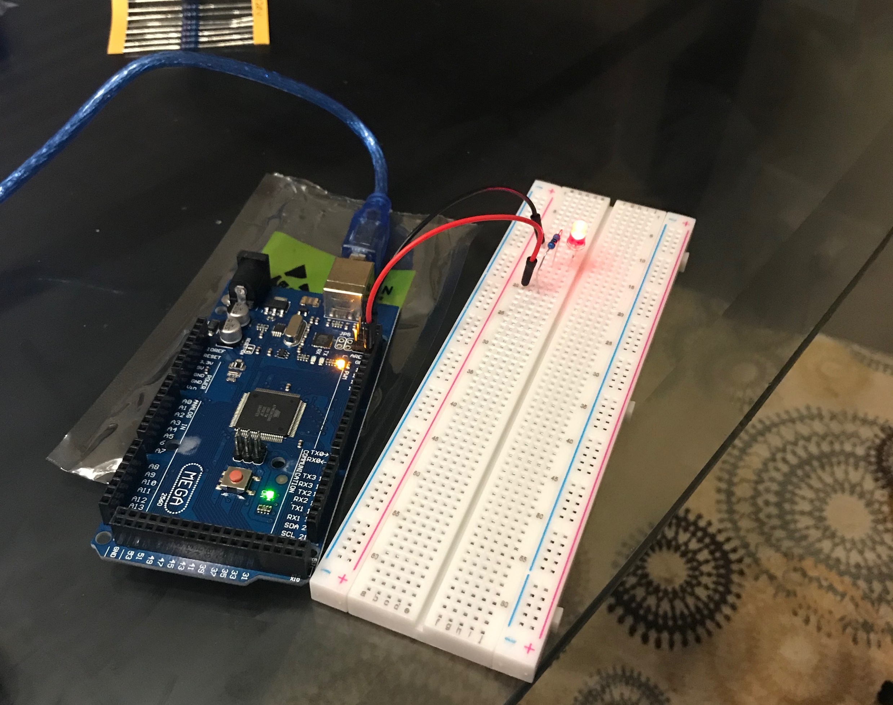
Circuit (Picture)
Arduino and breadboard with LED connected to breadboard

